Slide 1
ACI – Lab Session 2

Slide 2
Genetic Algorithm

Slide 3
Local search algorithms
Local search algorithms are used for evaluating and modifying one or more current states rather than systematically exploring paths from an initial state.
Suitable for problems that matters the solution state, not the path cost
Types
1. Genetic algorithms
2. Hill-climbing search
3. Simulated annealing
4. Local beam search

Slide 4
Genetic Algorithm
It is a subset of evolutionary algorithms, which is used in computing.
A genetic algorithm uses genetic and natural selection concepts to solve optimization problems.
Successor states are generated by combining two parent states rather than by modifying a single state

Slide 5
Genetic Algorithm – Basic terminologies
Population: Population is the subset of all possible or probable solutions, which can solve the given problem.
Chromosomes: A chromosome is one of the solutions in the population for the given problem, and the collection of gene generate a chromosome.
Gene: A chromosome is comprised of different genes, or it is an element of the chromosome.
Allele: Allele is the value provided to the gene within a particular chromosome.
Fitness Function: The fitness function is used to determine the individual's fitness level in the population. It means the ability of an individual to compete with other individuals. In every iteration, individuals are evaluated based on their fitness function.

Slide 6
Genetic Algorithm – Basic terminologies
Genetic Operators: In a genetic algorithm, the best individual mate to regenerate offspring better than parents. Here genetic operators play a role in changing the genetic composition of the next generation.
Selection
After calculating the fitness of every existent in the population, a selection process is used to determine which of the individualities in the population will get to reproduce and produce the seed that will form the coming generation.
So, now we can define a genetic algorithm as a heuristic search algorithm to solve optimization problems.
It is a subset of evolutionary algorithms, which is used in computing.
A genetic algorithm uses genetic and natural selection concepts to solve optimization problems.

Slide 7
Genetic Algorithm – How Genetic Algorithm Work?
The genetic algorithm works on the evolutionary generational cycle to generate high-quality solutions.
These algorithms use different operations that either enhance or replace the population to give an improved fit solution.
It basically involves five phases to solve the complex optimization problems, which are given as below:
Initialization
Fitness Assignment
Selection
Reproduction
Termination

Slide 8
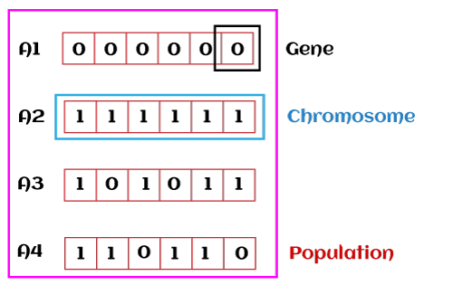
Genetic Algorithm – How Genetic Algorithm Work?
1. Initialization
The process of a genetic algorithm starts by generating the set of individuals, which is called population.
Here each individual is the solution for the given problem.
An individual contains or is characterized by a set of parameters called Genes.
Genes are combined into a string and generate chromosomes, which is the solution to the problem.
One of the most popular techniques for initialization is the use of random binary strings.

Slide 9
Genetic Algorithm – How Genetic Algorithm Work?
2. Fitness Assignment
Fitness function is used to determine how fit an individual is? It means the ability of an individual to compete with other individuals.
In every iteration, individuals are evaluated based on their fitness function.
The fitness function provides a fitness score to each individual. This score further determines the probability of being selected for reproduction.
The high the fitness score, the more chances of getting selected for reproduction.

Slide 10
Genetic Algorithm – How Genetic Algorithm Work?
3. Selection
The selection phase involves the selection of individuals for the reproduction of offspring.
All the selected individuals are then arranged in a pair of two to increase reproduction.
Then these individuals transfer their genes to the next generation.
There are three types of Selection methods available, which are:
Roulette wheel selection
Tournament selection
Rank-based selection

Slide 11
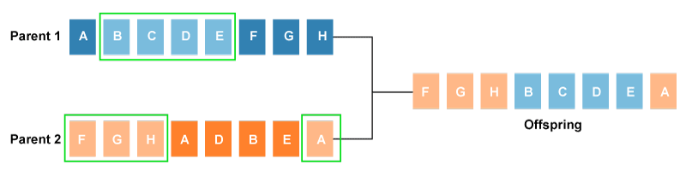
Genetic Algorithm – How Genetic Algorithm Work?
4. Reproduction
After the selection process, the creation of a child occurs in the reproduction step. In this step, the genetic algorithm uses two variation operators that are applied to the parent population. The two operators involved in the reproduction phase are given below:
Crossover: The crossover plays a most significant role in the reproduction phase of the genetic algorithm. In this process, a crossover point is selected at random within the genes. Then the crossover operator swaps genetic information of two parents from the current generation to produce a new individual representing the offspring.

Slide 12
Genetic Algorithm – How Genetic Algorithm Work?
4. Reproduction - Crossover
The genes of parents are exchanged among themselves until the crossover point is met.
These newly generated offspring are added to the population. This process is also called or crossover.
Types of crossover styles available:
One point crossover
Two-point crossover
Uniform crossover

Slide 13
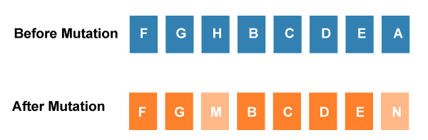
Genetic Algorithm – How Genetic Algorithm Work?
4. Reproduction
Mutation
The mutation operator inserts random genes in the offspring (new child) to maintain the diversity in the population.
It can be done by flipping some bits in the chromosomes.
Mutation helps in solving the issue of premature convergence and enhances diversification.
The below image shows the mutation process:

Slide 14
Genetic Algorithm – How Genetic Algorithm Work?
Types of mutation styles available,
Flip bit mutation
Gaussian mutation
Exchange/Swap mutation
5. Termination
After the reproduction phase, a stopping criterion is applied as a base for termination.
The algorithm terminates after the threshold fitness solution is reached.
It will identify the final solution as the best solution in the population.

Slide 15
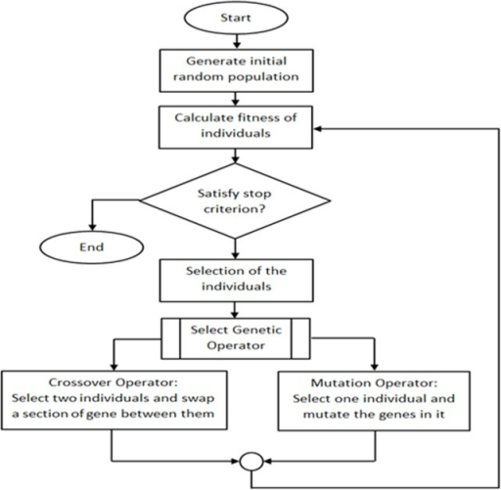
GA - Flowchart

Slide 16

Genetic Algorithm
Steps in Genetic Algorithm
Step 1-
Encoding technique- Binary encoding
Selection operator- Roulette Wheel Selection
Crossover operator- Single point crossover
Step 2-
Population size (n) = 4
Step 3-
Initial population (x value) = 13, 24, 8, 19

Slide 17
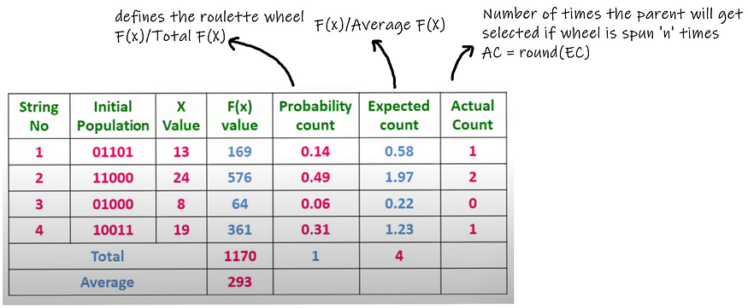
Genetic Algorithm
Step 4-
Calculate fitness
Survival rate or probability of selection

Slide 18
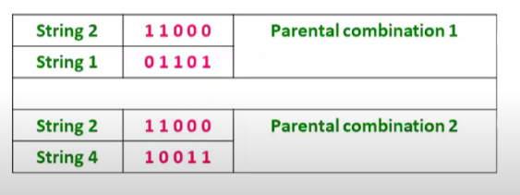
Genetic Algorithm
We see that if the Roulette wheel is spun four times, we’ll get 24 twice and 13 and 19 once. So possible parental combinations are (24,13) and (24,19).

Slide 19
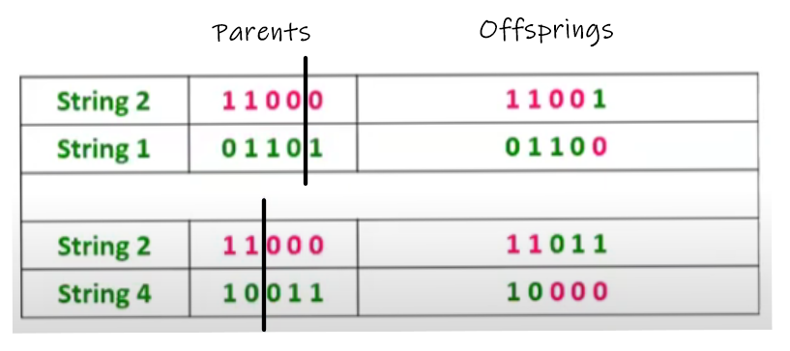
Genetic Algorithm
Step 5- Reproduction
1. Crossover
2. Mutation
1. Crossover – Swap the contents of the parents (solution) – In computing, parents can be represented as string, array, vector, etc.

Slide 20
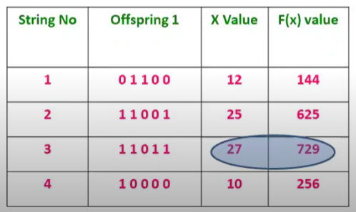
Genetic Algorithm
Step 6-
Calculation of fitness of off-spring
We can see that the maximum f(x) value has increased from 576 to 729.

Slide 21
Genetic Algorithm
Step 7-
Now we’ll take these four offsprings as parents and repeat the process until our termination condition is not satisfied.

